Slide 1
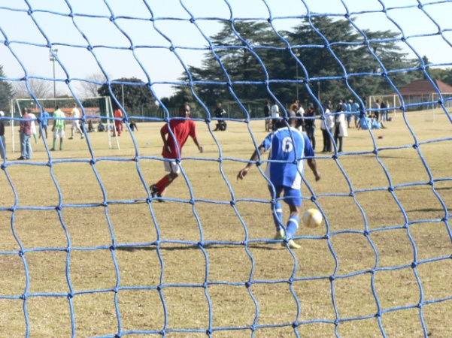
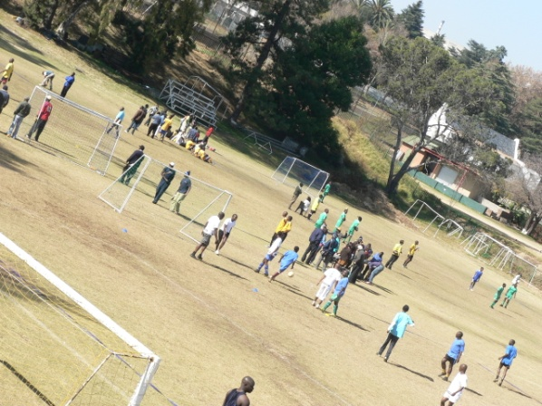
6 A-SIDE SOCCER @ ZOO LAKE SPORTS CLUB
Team Building Package Include:
Field Hire, Refs, Mini Tournament, Sound System & First Aid
Under 50 pax - R 5500 ex vat
50 pax and above – R 9295 ex vat
100 pax and above – R 14745 ex vat
200 pax and above – R 22695 ex vat
Larger groups – Price of request
Burger, fries and soft drinks – R 65 ex vat

